Slide 1

SMART INDIA HACKATHON 2025
TITLE PAGE
Problem Statement ID – | SIH25041
Problem Statement Title- | AI-Driven Unified Data Platform for Oceanographic, Fisheries, and Molecular Biodiversity Insights
Theme- | Sustainable Energy (Blue Economy & Marine Biodiversity)
PS Category- | Software
Team Name (Registered on portal) | Aqua Avengers

Slide 2
MARINEXPLORE
Aqua Avengers
Proposed Idea
Prototype
Our MVP demonstrates a cloud-ready, modular platform with:
Automated Data Ingestion Pipelines : Handling structured and unstructured datasets (oceanographic, fisheries, taxonomy, eDNA).
AI-Powered Modules : Species classification (taxonomy), otolith morphometrics visualization, biodiversity trend analysis.
Molecular Data Integration : eDNA storage, retrieval, and species matching using BLAST search.
Visualization Dashboards : Interactive graphs for oceanographic parameters, biodiversity indices, and fish distribution patterns.
APIs & Microservices : Scalable, interoperable architecture ensuring future adoption and integration.
AI-powered marine intelligence platform
Unifies ocean, fisheries & DNA data (breaks silos)
Automates ingestion , cleaning , analysis
Predictive AI & dashboards for faster insights
Collaboration tools for scientists & students
Proposed Solution
Data Ingestion Module → handles multi-format marine datasets
AI-Powered Engine → auto-cleaning, validation, ML predictions
Hybrid Storage → scalable + secure (structured & unstructured)
Visualization Dashboard → real-time, interactive insights
Collaboration Suite → co-create, analyze, publish seamlessly

Slide 3
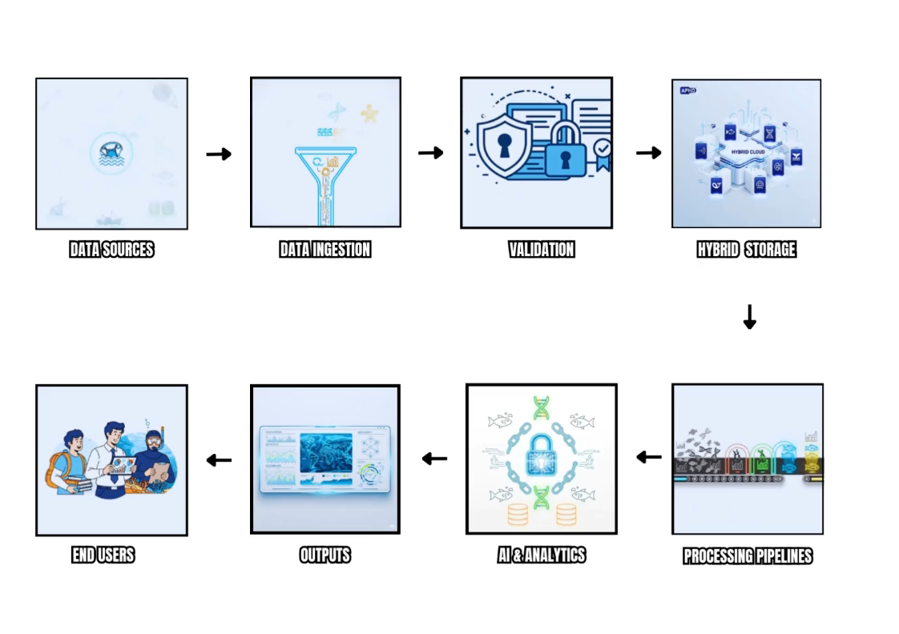
TECHNICAL APPROACH
Aqua Avengers
TECHNOLOGY
METHODOLOGY
Languages
  ➮Python for AI/ML
  ➮R for Statistics
  ➮JavaScript ( Node.js , React/Next.js ) for Web
Storage
  ➮PostgreSQL
  ➮MongoDB
  ➮MinIO
  ➮Redis
Infrastructure & Frameworks
    ➮TensorFlow ➮ PyTorch
    ➮Scikit-learn ➮ D3.js
    ➮Plotly ➮ Spark
    ➮BLAST+ ➮ OBIS/NCBI

Slide 4
FEASIBILITY AND VIABILITY
Aqua Avengers
Feasibility
Proven Open-Source Stack (Python, React, Docker) : Reliable & low-risk.
Modular & Cloud-Ready : Scalable, Containerized workflows (Oceanography, Fisheries, eDNA).
Interoperable & Standards-Compliant : Smooth Integration with Global datasets.
Strong Community Support : Reduces Risk, Accelerates Innovation.
Potential Challenges & Risks
Messy, Inconsistent data formats.
Frequent API changes.
Model accuracy doubts. (DATA OVERFITTING)
Scaling for big datasets ( ALL OCEANS )
Data Privacy concerns
Strategies to Overcome
Use validators & converters for clean data.
Implement version-locked APIs.
Regular expert validation & retraining.
Auto-scaling with Kubernetes for big data.
No-code intuitive UI for easy adoption.
Secure, private workspaces for compliance.

Slide 5
IMPACT
Aqua Avengers
BENEFITS
Audience Impact:
Easy access to Integrated marine data
Faster insights for scientists & fisheries managers
Collaboration and learning tools for students
Policymakers get evidence-based decisions
Long-Term Value:
Fosters open science & reproducibility
Accelerates innovation in marine research
Strengthens data-driven conservation policies
Aligns with India’s Blue Economy & SDG-14
Social Benefit:
Breaks marine data silos
Promotes collaboration across domains
No-code tools for non-tech users
Economic Benefit:
Cuts time & cost of data cleaning
Faster decision-making with AI/ML
Boosts evidence-based marine policies
Environmental Benefit:
Strengthens sustainable resource management
Supports biodiversity conservation
Aligns with UN SDG-14: Life Below Water

Slide 6
RESEARCH AND REFERENCES
Aqua Avengers
Key References & Useful Links
OBIS Manual DNA derived data (guidelines) Darwin Core extension, methods for linking occurrence and genetic data. manual.obis.org
Publishing DNA-derived data through biodiversity data platforms (GBIF / OBIS guide) docs.gbif.org
Case Study in Sharing Marine eDNA Metabarcoding Data to OBIS (NOAA, 2023) NOAA Institutional Repository
MIEM guidelines: Minimum Information for Reporting of eDNA Metabarcoding (2024) mbmg.pensoft.net
FathomNet: Global image dataset for AI in marine imagery arXiv
BOLD v4: The Barcode of Life Data System arXiv
IndOBIS – Indian Ocean Biodiversity Information System indobis.in

